Slide 1
Foot Traffic and Dwell Time Trends at Office Supply Stores During the Remote Work Shift
Analyzing customer behavior changes amid remote working trends
Notes:
AI-generated content may be incorrect. ---

Slide 2
Introduction & Context
Notes:
--- This slide references information from the following file: https://purdue0-my.sharepoint.com/personal/rsana_purdue_edu/_layouts/15/Doc.aspx?sourcedoc=%7BCB5F538E-AD73-4F91-A8F8-8F5817F554D1%7D&file=Group%207_Status_Report%20copy_deck%20reference.docx&action=default&mobileredirect=true Overview of the Study

Slide 3
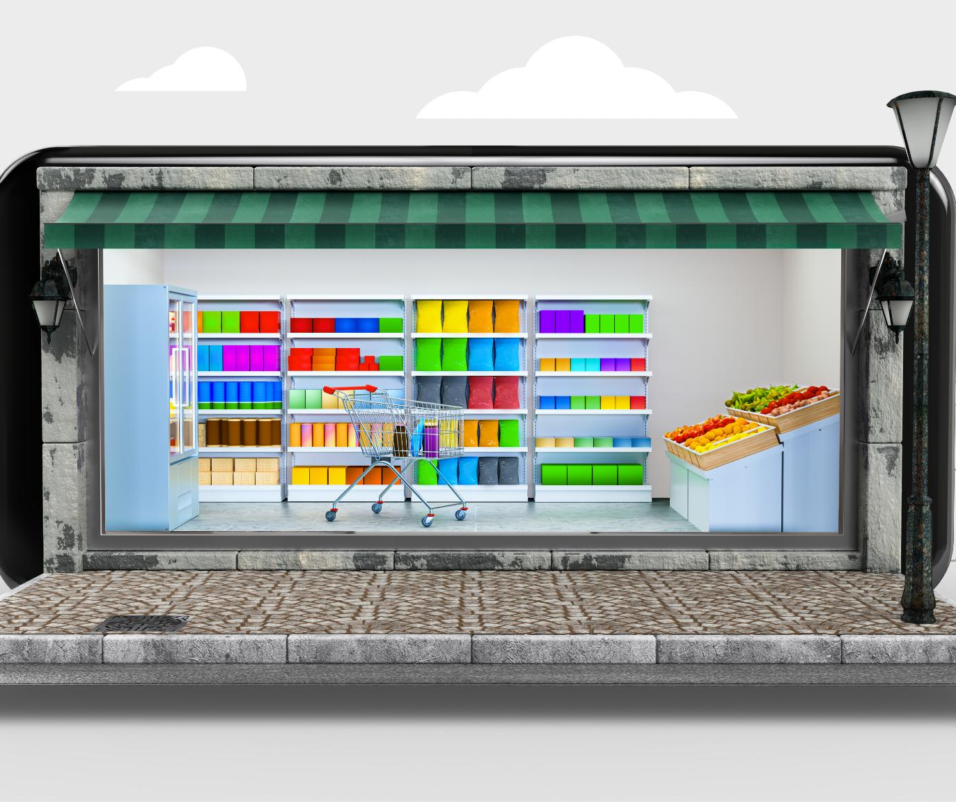
Overview of the Study
Remote Work Impact
The study examines how the 2020 remote work shift influenced consumer behavior at California office supply stores.
Foot Traffic and Dwell Time
Analysis focuses on foot traffic and dwell time trends in urban, suburban, and rural counties.
Demographic Influence
The study assesses how demographics like education, working-age population, and K–12 households affect store engagement.
Consumer Intent and Loyalty
Research investigates visit recovery, dwell time changes, and implications for consumer intent and brand loyalty.
Notes:
--- This slide references information from the following file: https://purdue0-my.sharepoint.com/personal/rsana_purdue_edu/_layouts/15/Doc.aspx?sourcedoc=%7BCB5F538E-AD73-4F91-A8F8-8F5817F554D1%7D&file=Group%207_Status_Report%20copy_deck%20reference.docx&action=default&mobileredirect=true This presentation explores the impact of the remote work shift during early 2020 on consumer behavior at office supply stores in California. The study focuses on foot traffic and dwell time trends across urban, suburban, and rural counties. Using datasets from SafeGraph and RUCA codes, the analysis investigates how different demographics—including education levels, working-age populations, and K–12 households—affected store engagement. The research aims to understand how quickly visits recovered, whether dwell times changed, and what these patterns suggest about consumer intent and brand loyalty.

Slide 4
Research Question 1
Notes:
--- This slide references information from the following file: https://purdue0-my.sharepoint.com/personal/rsana_purdue_edu/_layouts/15/Doc.aspx?sourcedoc=%7BCB5F538E-AD73-4F91-A8F8-8F5817F554D1%7D&file=Group%207_Status_Report%20copy_deck%20reference.docx&action=default&mobileredirect=true Foot Traffic & Demographics

Slide 5

Foot Traffic & Demographics
Foot Traffic Trends
Foot traffic peaked early 2020 before dropping sharply in March due to lockdowns, with Staples showing early recovery by Week 17.
Specialty Store Behavior
Specialty stores had fewer visitors but longer dwell times, indicating more focused and high-intent shopping.
Demographic Impact
Regions with more K–12 households, working-age, and educated populations showed distinct shopping engagement and dwell time patterns.
Engagement Patterns
Working-age populations had shorter visits, while educated consumers preferred longer visits reflecting personalized shopping experiences.
Notes:
--- This slide references information from the following file: https://purdue0-my.sharepoint.com/personal/rsana_purdue_edu/_layouts/15/Doc.aspx?sourcedoc=%7BCB5F538E-AD73-4F91-A8F8-8F5817F554D1%7D&file=Group%207_Status_Report%20copy_deck%20reference.docx&action=default&mobileredirect=true During the first four months of 2020, foot traffic at office supply stores peaked in January and February before sharply declining in March (Week 12) due to lockdowns. Staples showed a notable rebound in Week 17 with nearly 98K visits, indicating early recovery driven by home-office needs. Specialty stores such as Papyrus and Rapid Refill had fewer visits but significantly longer dwell times, suggesting high-intent shopping behavior. Demographic factors played a crucial role: areas with higher concentrations of K–12 households, working-age populations, and educated consumers exhibited distinct engagement patterns. For example, counties with more working-age residents showed shorter dwell times, while highly educated regions had longer visits, reflecting a preference for personalized shopping experiences.

Slide 6
Research Question 2
Notes:
--- This slide references information from the following file: https://purdue0-my.sharepoint.com/personal/rsana_purdue_edu/_layouts/15/Doc.aspx?sourcedoc=%7BCB5F538E-AD73-4F91-A8F8-8F5817F554D1%7D&file=Group%207_Status_Report%20copy_deck%20reference.docx&action=default&mobileredirect=true Suburban vs Urban Recovery

Slide 7
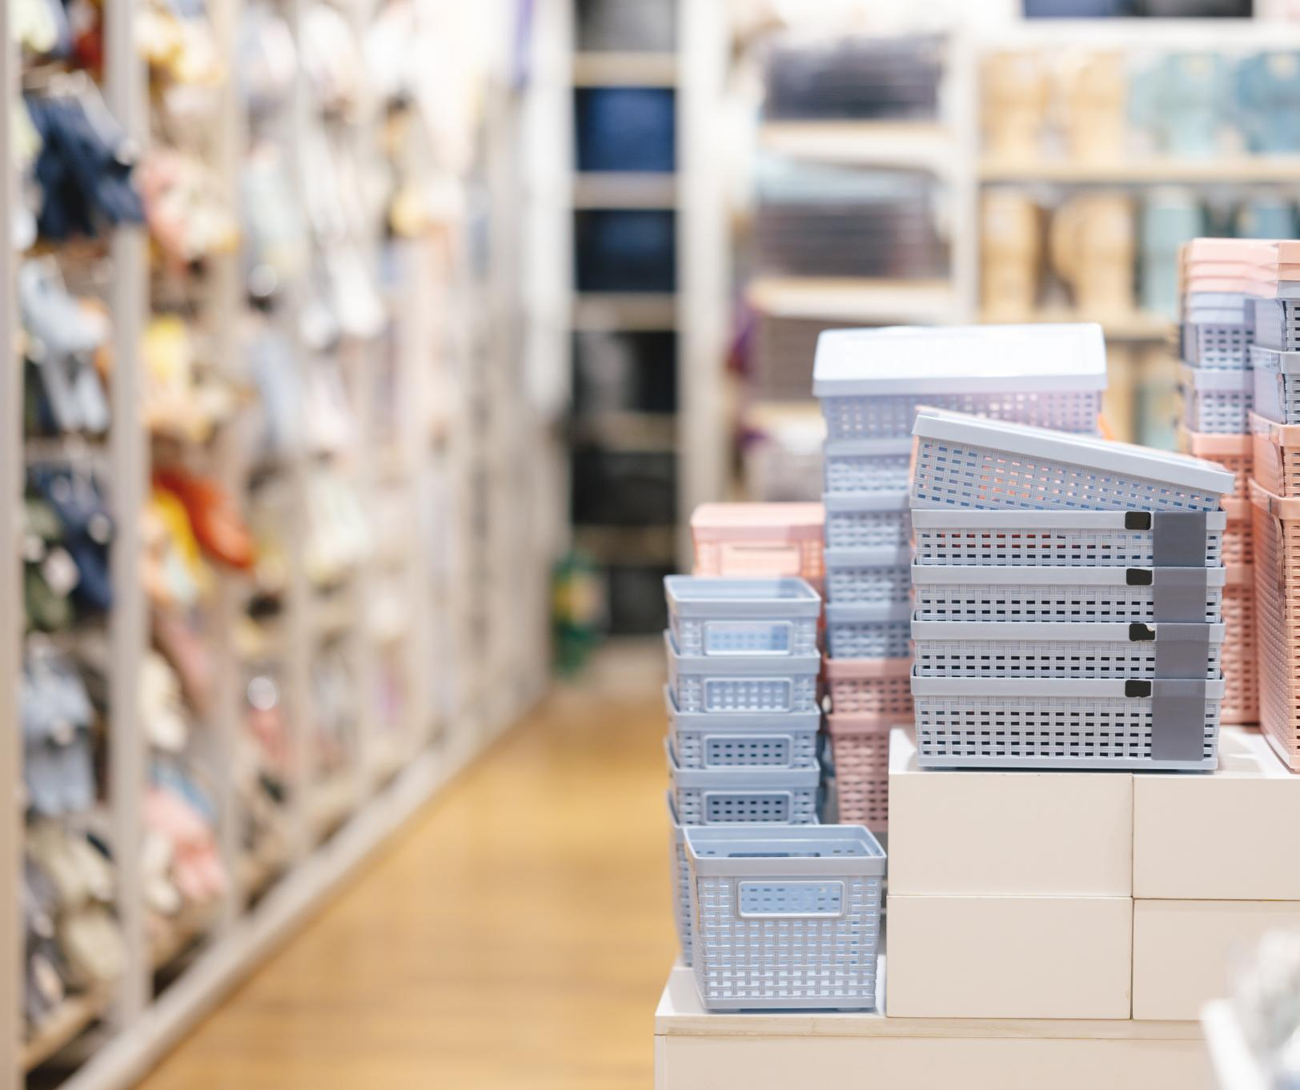
Suburban vs Urban Recovery
Suburban Store Engagement
Suburban counties showed the highest foot traffic and engagement at office supply stores during the early remote work period.
Urban Shopping Behavior
Urban areas had slightly fewer visits but maintained similar dwell times, indicating quick and goal-oriented shopping trips.
Rural Visit Patterns
Rural counties experienced fewer visits but longer dwell times, suggesting more leisurely or necessity-driven shopping.
Regional Demand Variation
Los Angeles County was a hotspot for office supply demand, highlighting regional differences in consumer adaptation.
Notes:
--- This slide references information from the following file: https://purdue0-my.sharepoint.com/personal/rsana_purdue_edu/_layouts/15/Doc.aspx?sourcedoc=%7BCB5F538E-AD73-4F91-A8F8-8F5817F554D1%7D&file=Group%207_Status_Report%20copy_deck%20reference.docx&action=default&mobileredirect=true Suburban counties demonstrated the highest levels of foot traffic and engagement at office supply stores during the early remote work shift. Staples and Office Depot led the recovery in these regions, benefiting from their strong suburban presence and supply chains. Urban areas experienced slightly lower visit volumes but maintained similar dwell times, indicating quick, goal-oriented shopping trips. In contrast, rural counties saw fewer visits but longer dwell times, suggesting more leisurely or necessity-driven shopping. Los Angeles County emerged as a hotspot for office supply demand, highlighting regional variations in consumer adaptation. These findings underscore the importance of geographic context in retail recovery and consumer behavior during the pandemic.

Slide 8
Research Question 3
Notes:
--- This slide references information from the following file: https://purdue0-my.sharepoint.com/personal/rsana_purdue_edu/_layouts/15/Doc.aspx?sourcedoc=%7BCB5F538E-AD73-4F91-A8F8-8F5817F554D1%7D&file=Group%207_Status_Report%20copy_deck%20reference.docx&action=default&mobileredirect=true Brand Stabilization & Loyalty

Slide 9
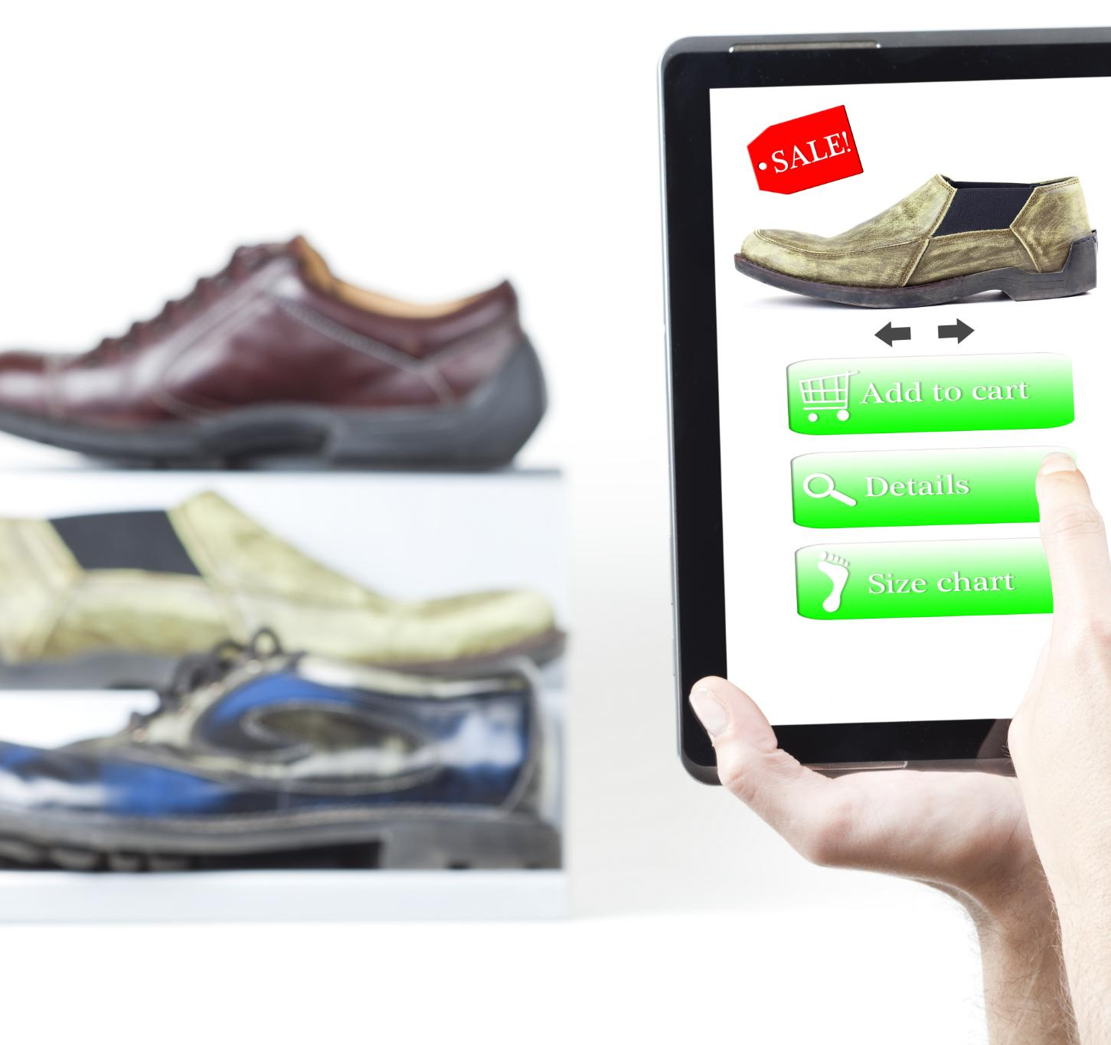
Brand Stabilization & Loyalty
Early Foot Traffic Stabilization
Staples and Office Depot showed early stabilization in foot traffic and dwell times, reflecting their essential status.
Brand Loyalty Impact
Strong brand loyalty contributed to Staples’ rapid rebound and Office Depot’s steady recovery during remote work shifts.
Specialty Brand Purchase Patterns
Specialty brands had low traffic but high dwell times, indicating focused, high-value purchases from trusted customers.
Supply Chain and Location Advantage
Retailers with reliable supply chains and suburban locations met consumer needs better during remote work transitions.
Notes:
--- This slide references information from the following file: https://purdue0-my.sharepoint.com/personal/rsana_purdue_edu/_layouts/15/Doc.aspx?sourcedoc=%7BCB5F538E-AD73-4F91-A8F8-8F5817F554D1%7D&file=Group%207_Status_Report%20copy_deck%20reference.docx&action=default&mobileredirect=true Staples and Office Depot exhibited early stabilization in foot traffic and dwell times, with Staples rebounding rapidly by Week 17. This pattern reflects strong brand loyalty and the perception of these retailers as essential for remote work setups. Office Depot maintained a steady recovery, while OfficeMax lagged behind, possibly due to brand overlap and diluted traffic. Specialty brands like Papyrus and Rapid Refill experienced low traffic but high dwell times, indicating focused, high-value purchases. These trends suggest that essential status and customer trust played key roles in driving early recovery. Retailers with reliable supply chains and strong suburban footprints were better positioned to meet consumer needs during the transition to remote work.

Slide 10
Overall Conclusions
Notes:
--- This slide references information from the following file: https://purdue0-my.sharepoint.com/personal/rsana_purdue_edu/_layouts/15/Doc.aspx?sourcedoc=%7BCB5F538E-AD73-4F91-A8F8-8F5817F554D1%7D&file=Group%207_Status_Report%20copy_deck%20reference.docx&action=default&mobileredirect=true Summary of Insights

Slide 11

Summary of Insights
Suburban Consumer Adaptation
Suburban consumers adapted faster to remote work, boosting office supply store foot traffic and dwell times.
Leading Retailers
Staples and Office Depot led due to brand strength and their essential retail status during the shift.
Demographic Influence
Education, working-age density, and household makeup significantly shaped consumer shopping behaviors.
Consumer Shopping Preferences
Efficiency-driven consumers preferred quick visits to high-traffic stores; experience-driven shoppers valued longer specialty store visits.
Notes:
--- This slide references information from the following file: https://purdue0-my.sharepoint.com/personal/rsana_purdue_edu/_layouts/15/Doc.aspx?sourcedoc=%7BCB5F538E-AD73-4F91-A8F8-8F5817F554D1%7D&file=Group%207_Status_Report%20copy_deck%20reference.docx&action=default&mobileredirect=true The study concludes that suburban consumers adapted more quickly to remote work demands, leading to faster recovery in foot traffic and dwell times at office supply stores. Staples and Office Depot emerged as leaders due to their brand strength and essential status. Demographic factors such as education level, working-age density, and household composition significantly influenced shopping behavior. Efficiency-driven consumers favored quick trips to high-traffic retailers, while experience-driven shoppers spent more time in specialty stores. These insights highlight the need for retailers to tailor strategies based on local consumer profiles and preferences, especially in response to sudden shifts in work and lifestyle patterns.

